Slide 1
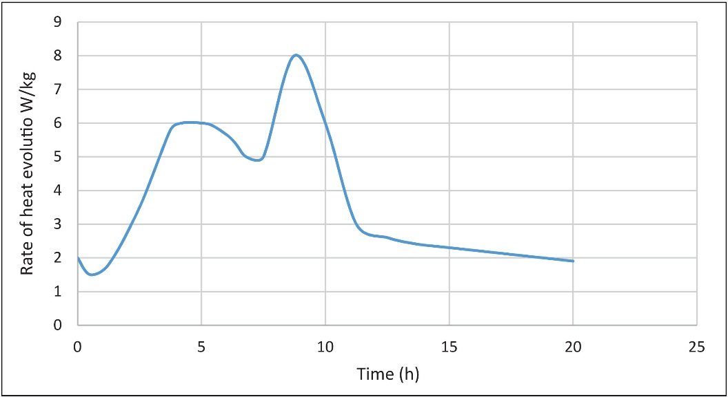
FIGURE 20.1 Typical Plot of Rate of Heat Evolution From OPC/Water at 20°C

Slide 2
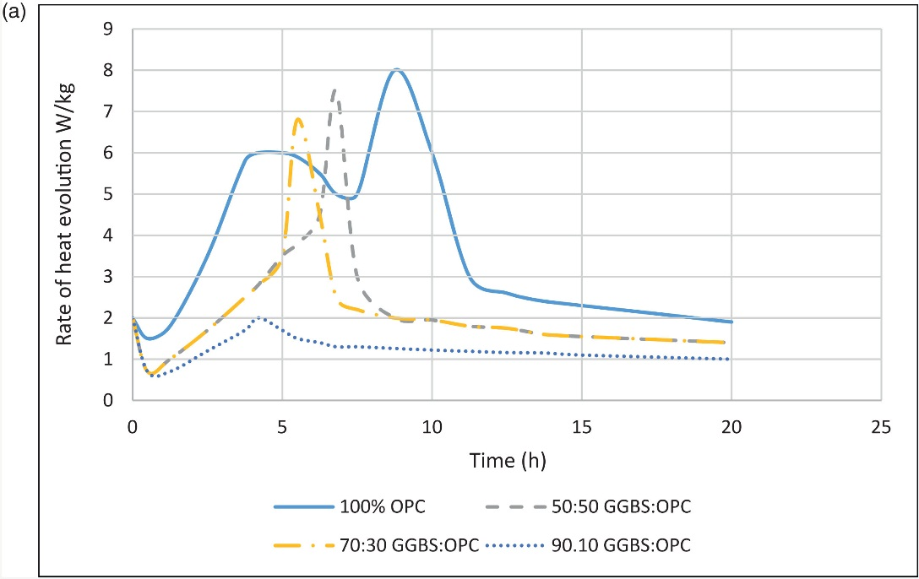
FIGURE 20.2a Heat Generation From Concrete with Blastfurnace Slag

Slide 3
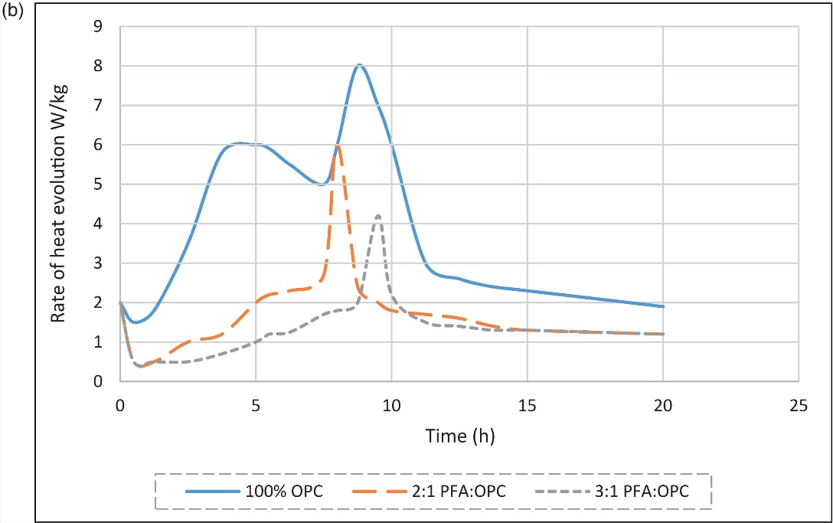
FIGURE 20.2 b Heat Generation From Concrete with Pulverised Fuel Ash

Slide 4
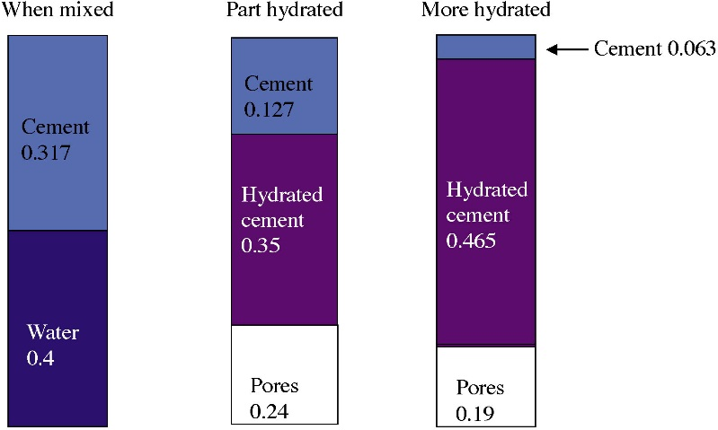
FIGURE 20.3 Progress of Hydration for Tutorial Question 1

Slide 5
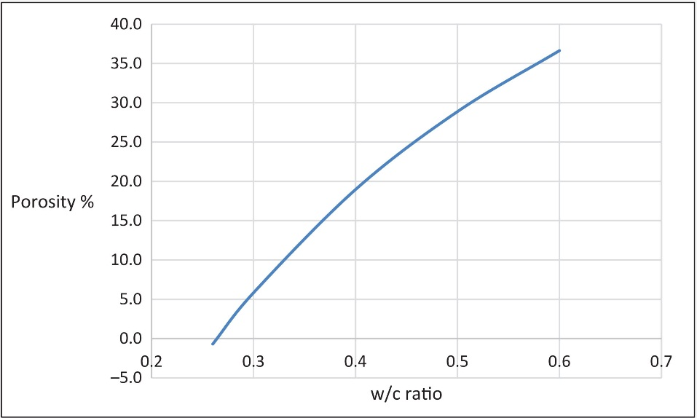
FIGURE 20.4 Porosity Versus w/c Ratio for Full Hydration

Slide 6
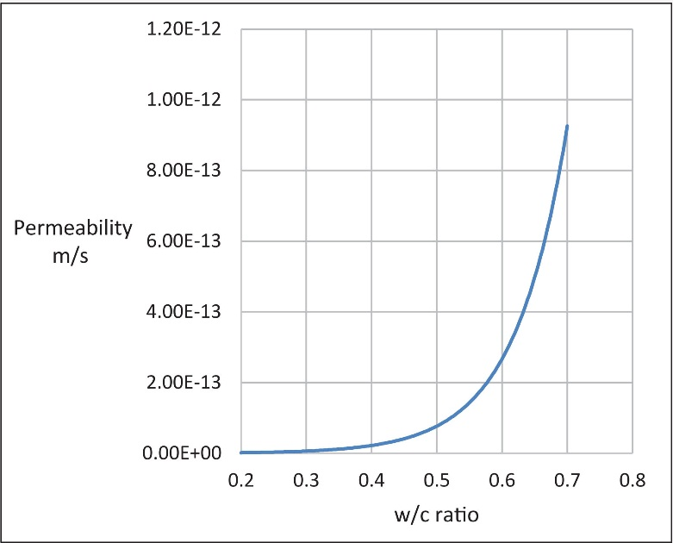
FIGURE 20.5 The Effect of w/c Ratio on Permeability

Slide 7
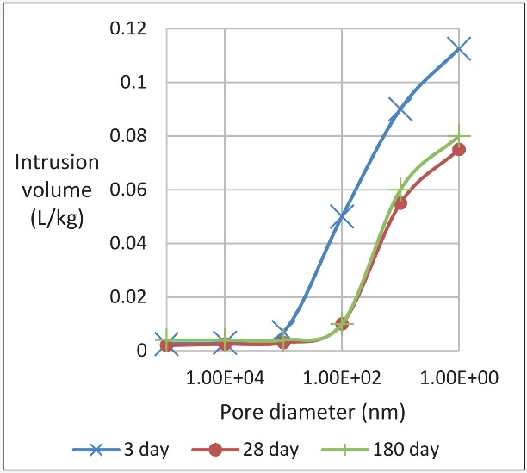
FIGURE 20.6 Cumulative Pore Volume at Different Ages

